Slide 1


Image Classification using Artificial Neural Network
James Ng
2019-09-27

Slide 2

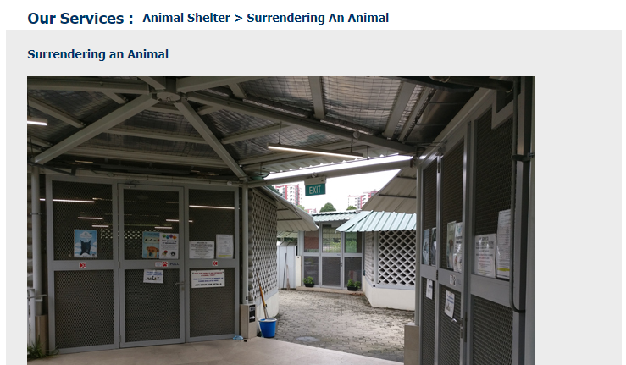
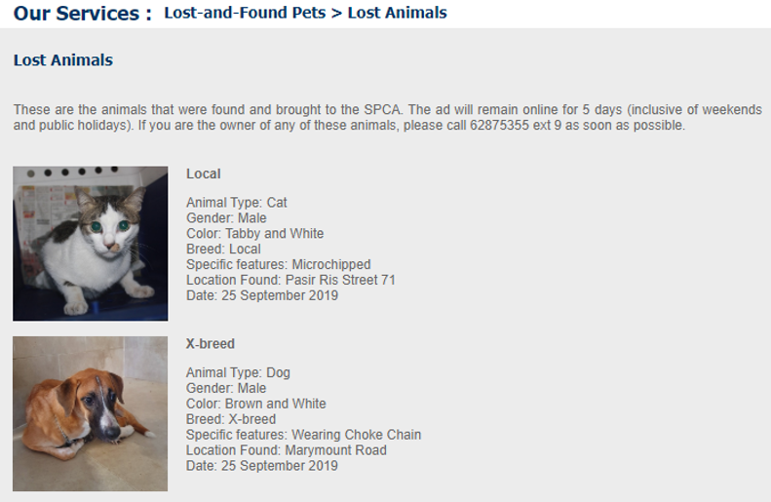
Animal Shelter
7,000 to 9,000
animals each year

Slide 3



Slide 4

Project Goal
Identification of pet breeds
Society for the Prevention of Cruelty to Animals
(SPCA)
Identification of bird species
National Parks Board
(NParks)

Slide 5


Approach
Image classification
Simple neural network model
Convolutional Neural Network model
Transfer Learning using VGG16

Slide 6

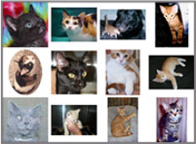
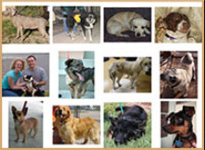
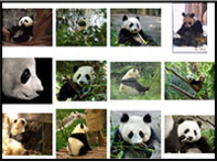
Image classification – simple neural network
3 classes
Cat
Dog
Panda
2400
training images
600
testing images
Dataset:
pyimagesearch
Notes:
May require more than one slide

Slide 7
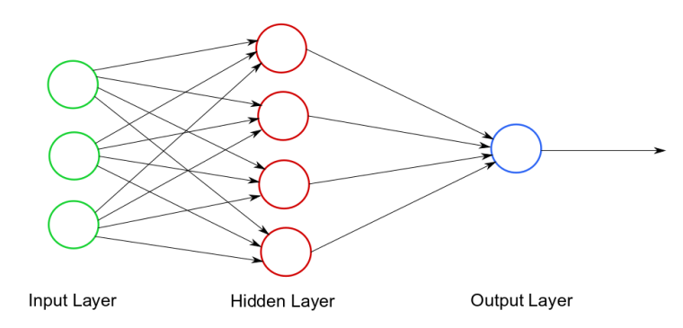
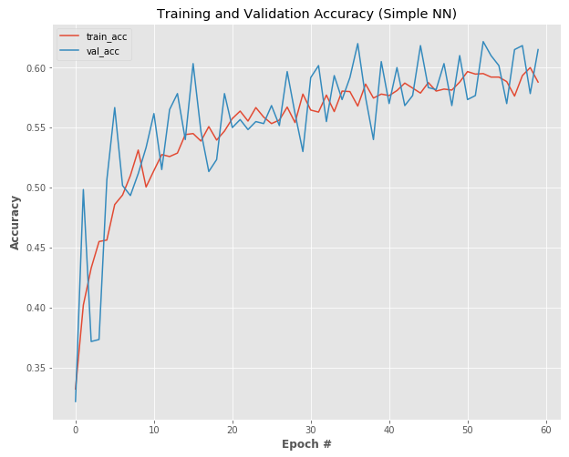
Simple neural network
Training time = 4 minutes
Accuracy = 61%

Slide 8
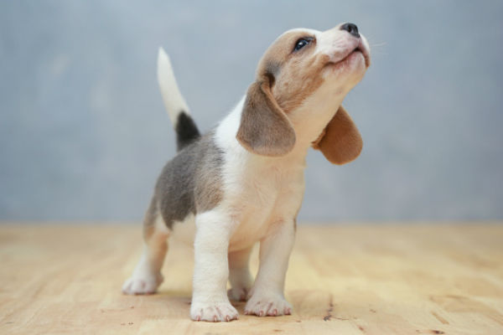
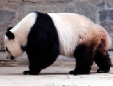
Classification results

Slide 9
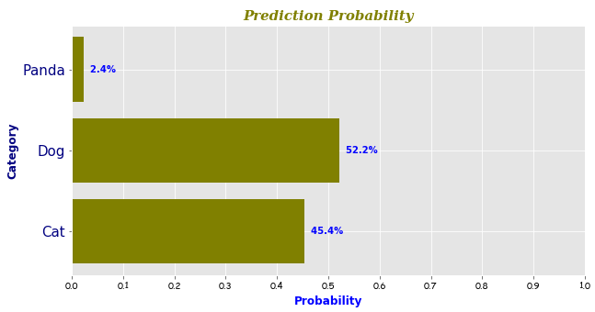
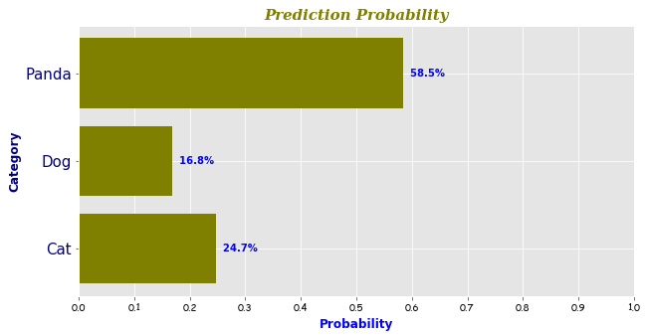
Classification results
Dog 52.2%
Panda 58.5%

Slide 10


Classification results

Slide 11
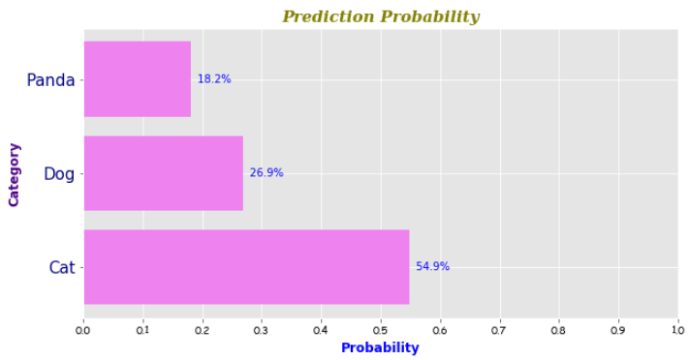
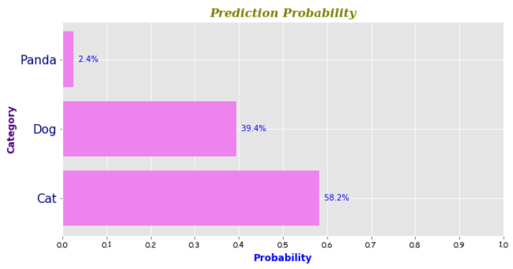
Classification results
Cat 54.9%
Cat 58.2%

Slide 12
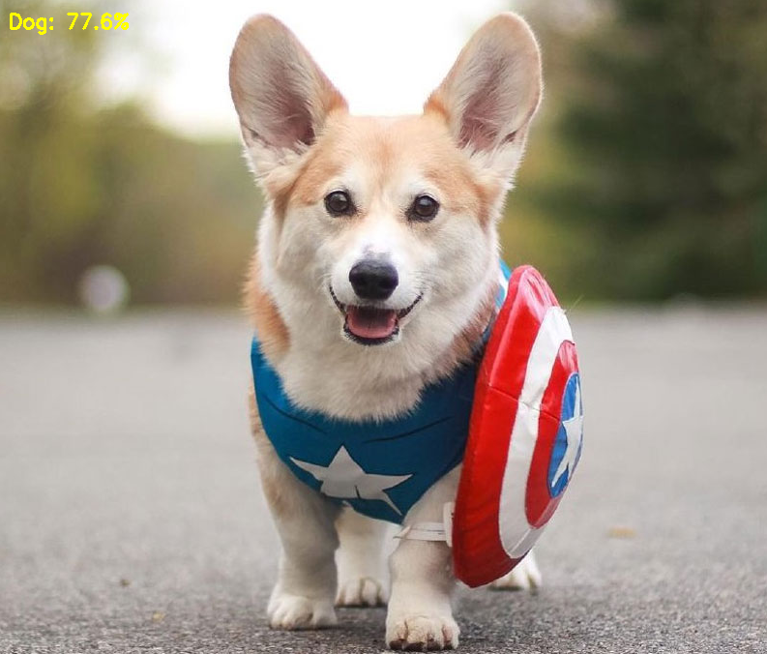
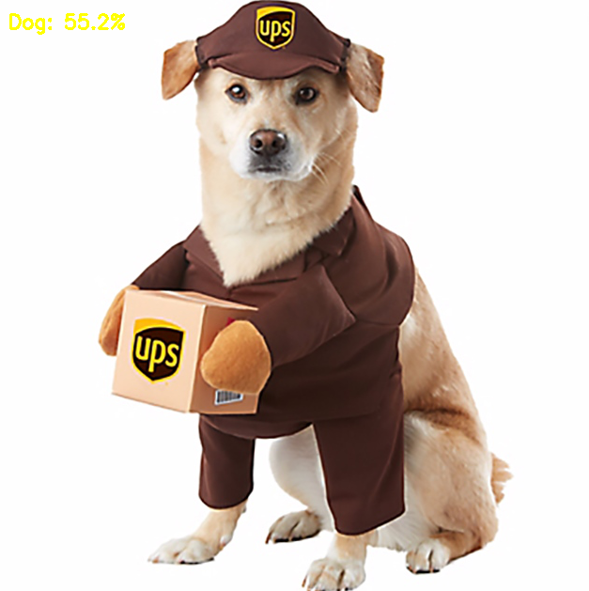
Classification results

Slide 13
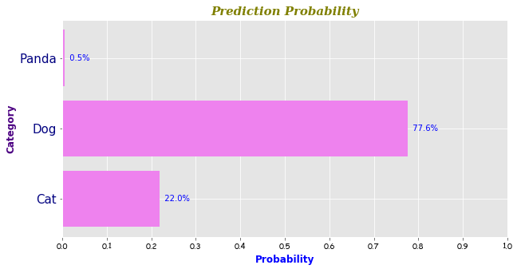
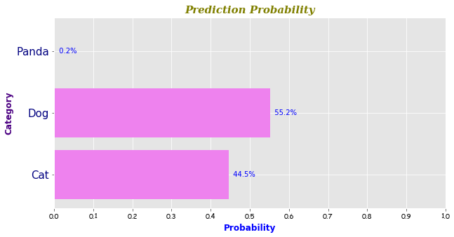
Classification results
Dog 77.6%
Dog 55.2%

Slide 14
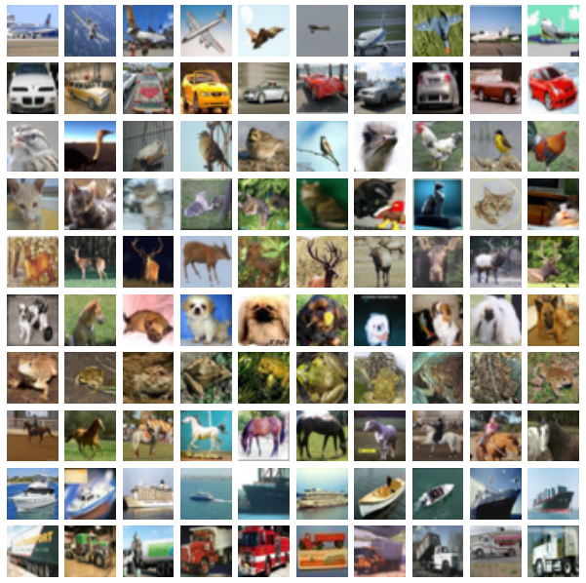
Image classification – convolutional neural network
10 classes
Airplane
Car
Bird
Cat
Deer
Dog
Frog
Horse
Ship
Truck
50,000
training images
10,000
testing images
Dataset:
CIFAR-10
Notes:
May require more than one slide

Slide 15
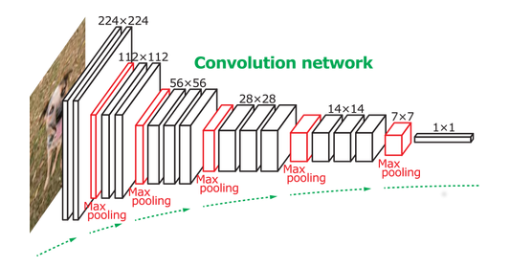

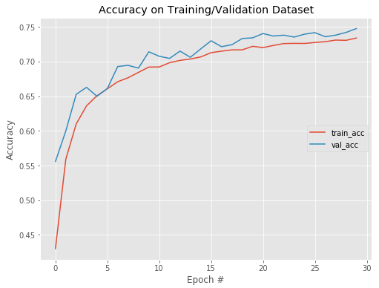
Convolutional neural network
Training time = 4 hours
Accuracy = 75%

Slide 16
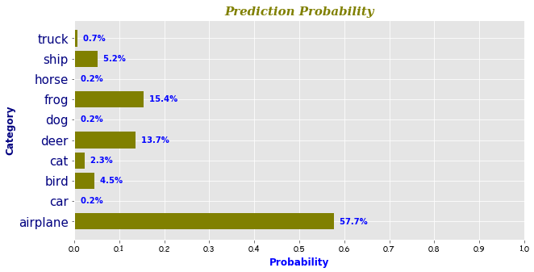
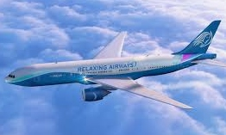
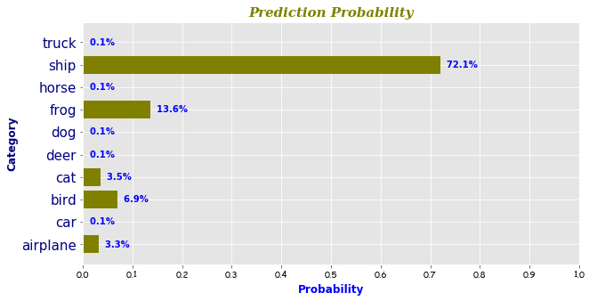
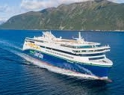
Classification results
Airplane 57.7%
Ship 72.1%

Slide 17
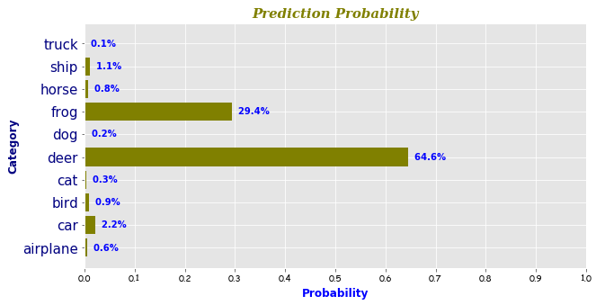
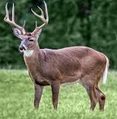
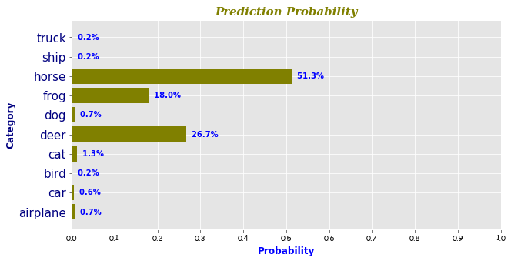
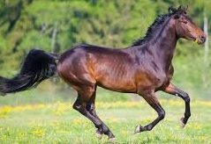
Classification results
Deer 64.6%
Horse 51.3%

Slide 18
Classification results
Deer 64.6%
Horse 51.3%

Slide 19
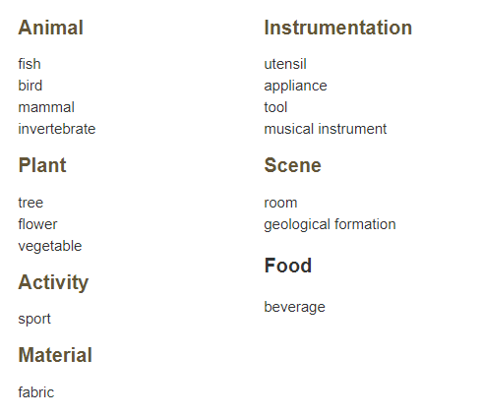
Image classification – transfer learning
1000 classes
1,200,000
training images
150,000
testing images
Pre-trained model:
VGG16
University of Oxford
Notes:
May require more than one slide

Slide 20
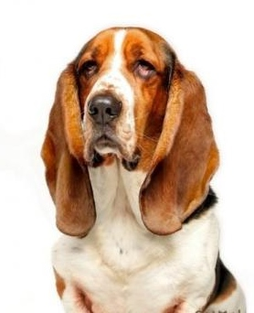
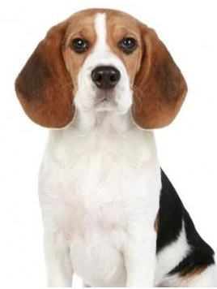
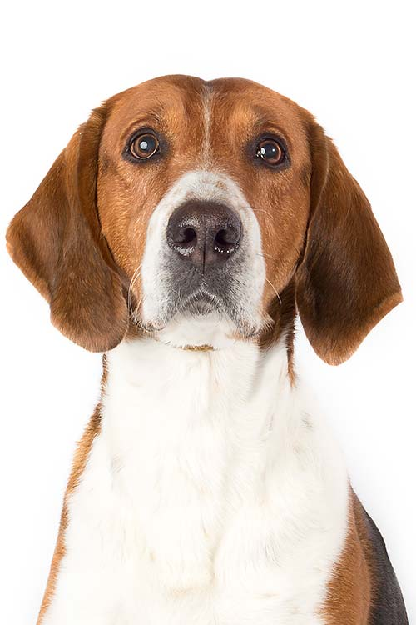
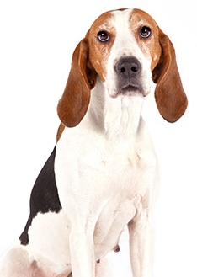
Classification results

Slide 21
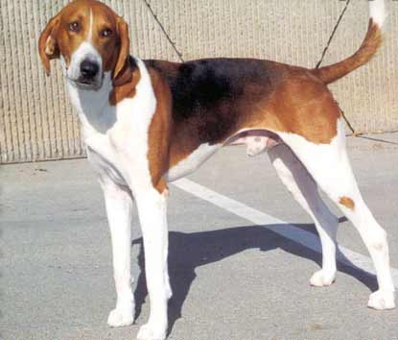
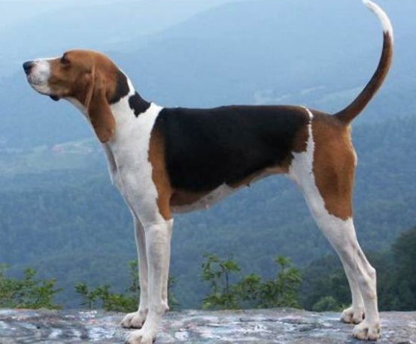
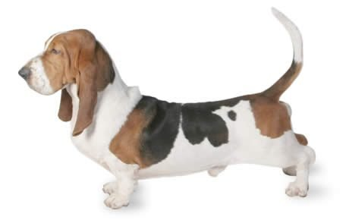
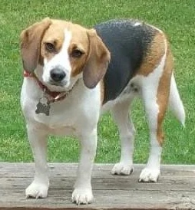
Classification results
English foxhound 48.4%
Walker hound 51.4%
Basset 79.6%
Beagle 56.5%

Slide 22
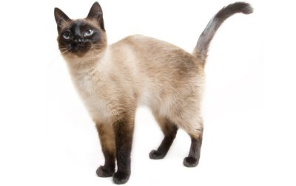
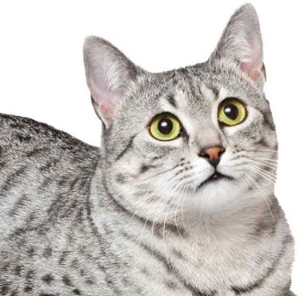
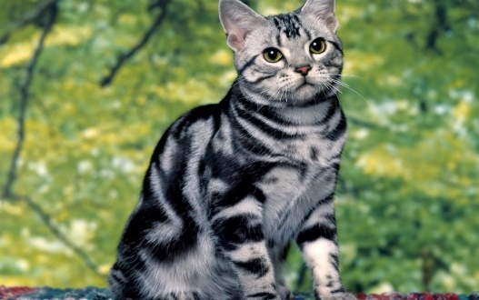
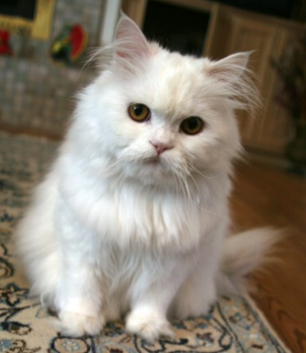
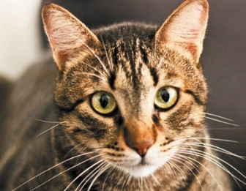
Classification results

Slide 23
Classification results
Siamese cat 99.9%
Egyptian cat 77.3%
Tiger cat 36.2%
Persian cat 94.9%
Tabby cat 68.4%

Slide 24
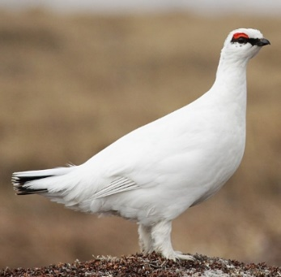
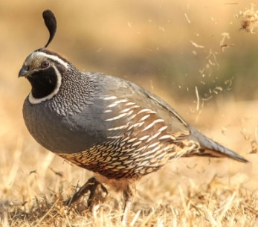
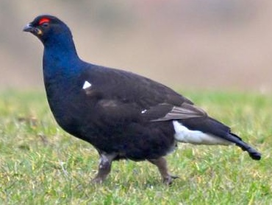
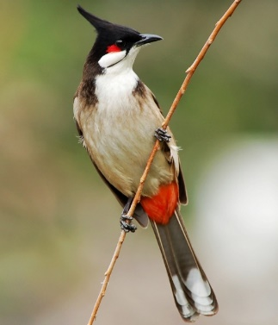
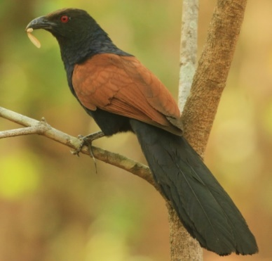
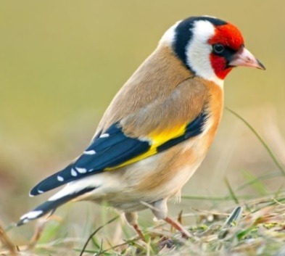
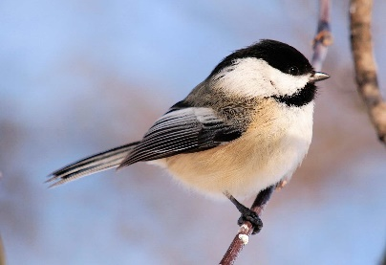
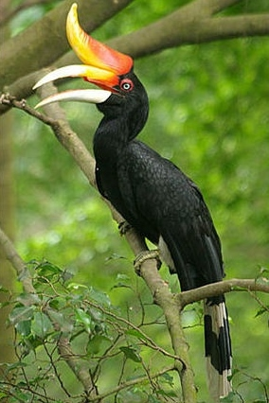




Classification results

Slide 25
Classification results
Quail 99.6%
Black grouse 99.9%
Ptarmigan 99.9%
Bulbul 99.9%
Chickadee 99.9%
Goldfinch 99.9%
Coucal 99.9%
Hornbill 99.9%
Indigo bunting 99.9%
Jay 99.9%
Magpie 99.9%
Partridge 81.6%

Slide 26



Next Steps
To train the model on common birds and animals found in Singapore

Slide 27

“The model is as intelligent as you train it to be”

Slide 28





Metis Projects
Computer Vision (CV) image classification using artificial neural network
Natural Language Processing (NLP) to analyse product reviews by online shoppers
Classification analysis on Telco customer churn
Regression analysis to predict life expectancy on a country level
Exploratory Data Analysis on NYC MTA turnstile data

Slide 29


Metis Projects
Computer Vision (CV) image classification using artificial neural network
Natural Language Processing (NLP) to analyse product reviews by online shoppers
Classification analysis on Telco customer churn
Regression analysis to predict life expectancy on a country level
Exploratory Data Analysis on NYC MTA turnstile data
Thank You
James Ng
2019-09-27
www.linkedin.com/in/jnyh/

Slide 30




https://metis.kaplan.com.sg
https://github.com/JNYH
Add to Contacts
https://medium.com/@jamesngyh
https://www.linkedin.com/in/jnyh/

Slide 31



Coastal surveillance to identify floating objects, e.g. log, shark, illegal immigrant
Anomaly detection in medical scans
Autonomous vehicle to identify surrounding objects

Slide 32



Breed identification
Miniature poodle 60.3%
Standard poodle 87.8%
Toy poodle 68.7%

Slide 33






Breed identification
Cheetah 99.3%
Leopard 98.5%
Cougar 77.8%
Lynx 99.9%
Jaguar 60.5%
Snow Leopard 92.4%

Slide 34





Breed identification
Guinea pig 99.5%
Guinea pig 99.9%
Guinea pig 99.9%
Guinea pig 72.6%
Pig 25.8%

Slide 35













Challenging images for classification

Slide 36





Classification results
Pickup truck 97.2%
Garbage truck 99.6%
Tow truck 76.4%
Fire truck 99.1%
Trailer truck 76.3%

Slide 37




Classification results
Street sign 97.3%
Traffic light 97.3%
Street sign 98.5%
Traffic light 99.9%

